Slide 1
1
Front End Engineering
Project
CURRENCY CONVERTER
Team Details: Pallavi Thakur (2310990844)
Madhav Keshav Singla (2310991366)
Dhruv Suneja (2310991367)
Faculty Coordinator: Mrs. Gunjan Thakur
:
Chitkara University Institute of Engineering and Technology,
Chitkara University, Punjab

Slide 2
2
Table of Contents
Introduction
Problem Statement
Technical Details
Key Features
Project Highlights
Bonus Feature(optional)
Conclusion
References/Links used

Slide 3
3
Introduction
Brief Overview:
This project is a Currency Converter that helps the user to convert one currency to another.
Purpose:
A currency converter will help international travellers study the price of foreign goods and services, helping cost-conscious visitors find out how much their money is worth while travelling overseas.

Slide 4
Problem Statement
4
Problem Statement:
Not able to convert currency fast enough?
Not updated with current exchange rates?
If you have similar problems regarding currency conversion then worry not, because currency converter is here for you.

Slide 5

Technical Details
5
Hardware Details:
Device name Dhruv
Processor AMD Ryzen 7 6800H with Radeon Graphics 3.20 GHz
Installed RAM 8.00 GB (7.19 GB usable)
Device ID C0588497-3BD2-46D4-91DE-671868B90C4B
Product ID 00342-42595-27295-AAOEM
System type 64-bit operating system, x64-based processor
Pen and touch No pen or touch input is available for this display
Software Details:
Visual Studio Code version 1.83

Slide 6
Key Features
6
Key Features:
Show accurate exchange rates between different currencies.
UI design is pleasing to the user’s eyes.
In this currency converter, users are provided with an option to select the type of conversion, i.e. from 'this' currency to 'that' currency.
Ensuring accurate and up-to-date exchange rates.

Slide 7
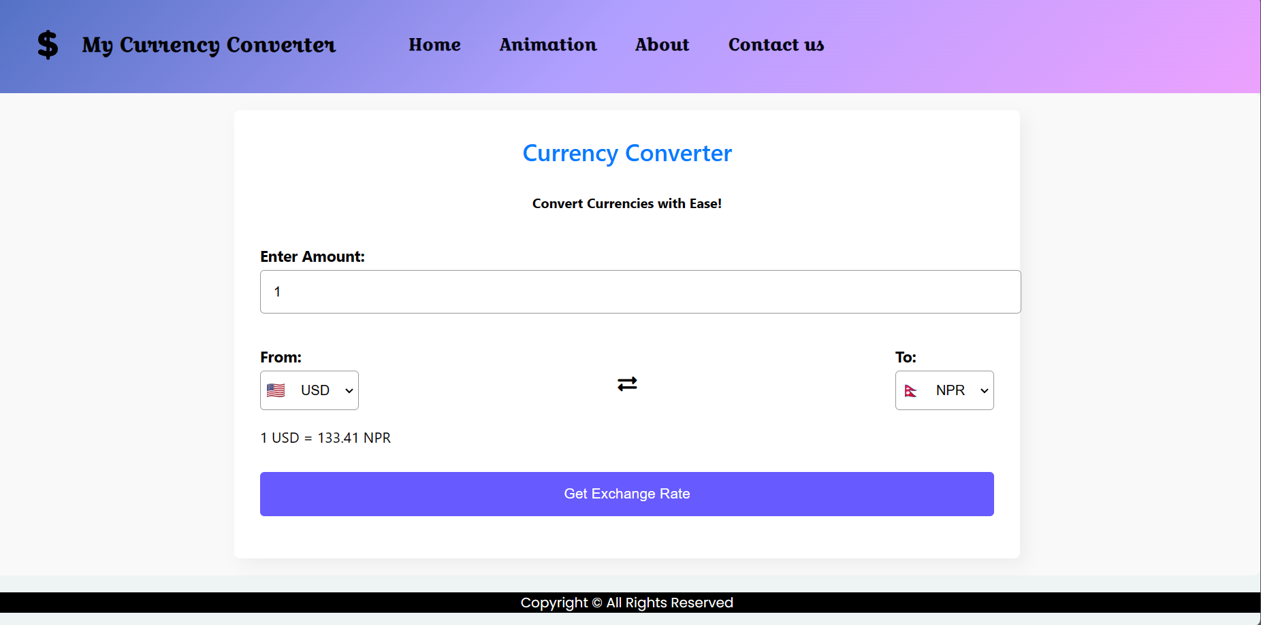
Project Highlights
7

Slide 8

Project Highlights
8

Slide 9
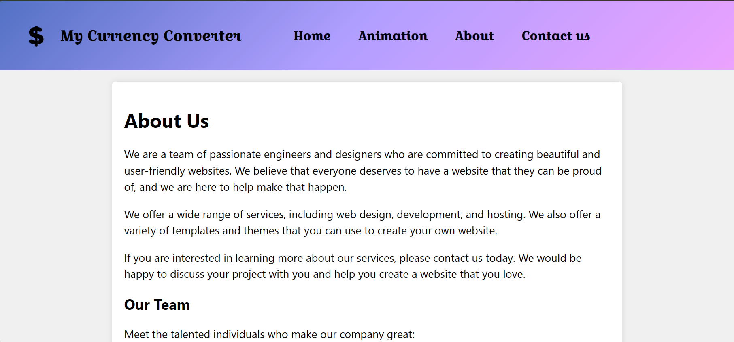
Project Highlights
9

Slide 10
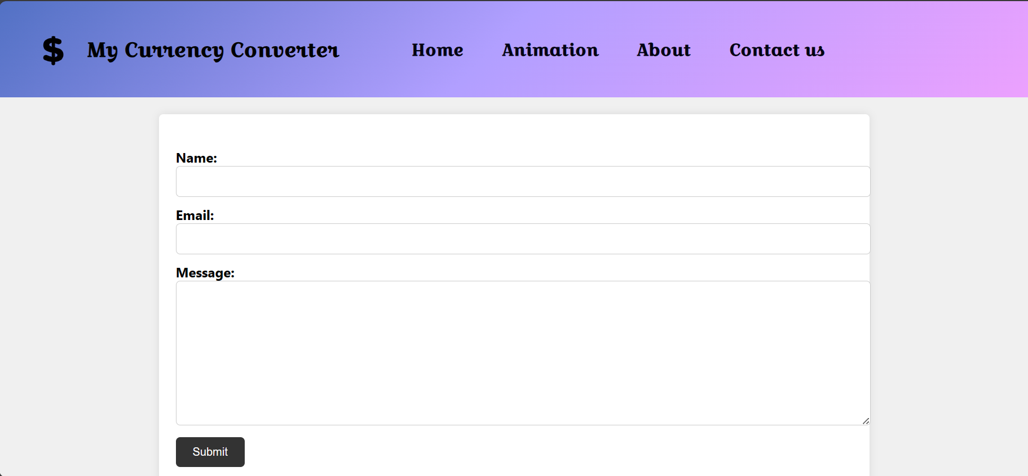
Project Highlights
10

Slide 11
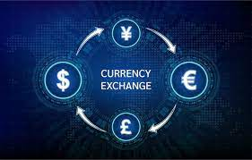
Conclusion
11
CURRENCY CONVERTER that the people are using, they will always find ways to get the highest possible profits out of exchanges.
To those who are going to travel , it is wise thing to check the different foreign exchange options , they have beforehand.

Slide 12
References/Links used
12
https://www.freepik.com/free-photos- vectors/gradient-background
https://www.freepik.com/free-photos-vectors/dollar-logo
https://fonts.google.com
https://developer.mozilla.org/en- US/docs/Web/CSS/color
https://flagcdn.com/48x36/
https://v6.exchangerate-api.com/v6/

Slide 13

13

